Slide 1
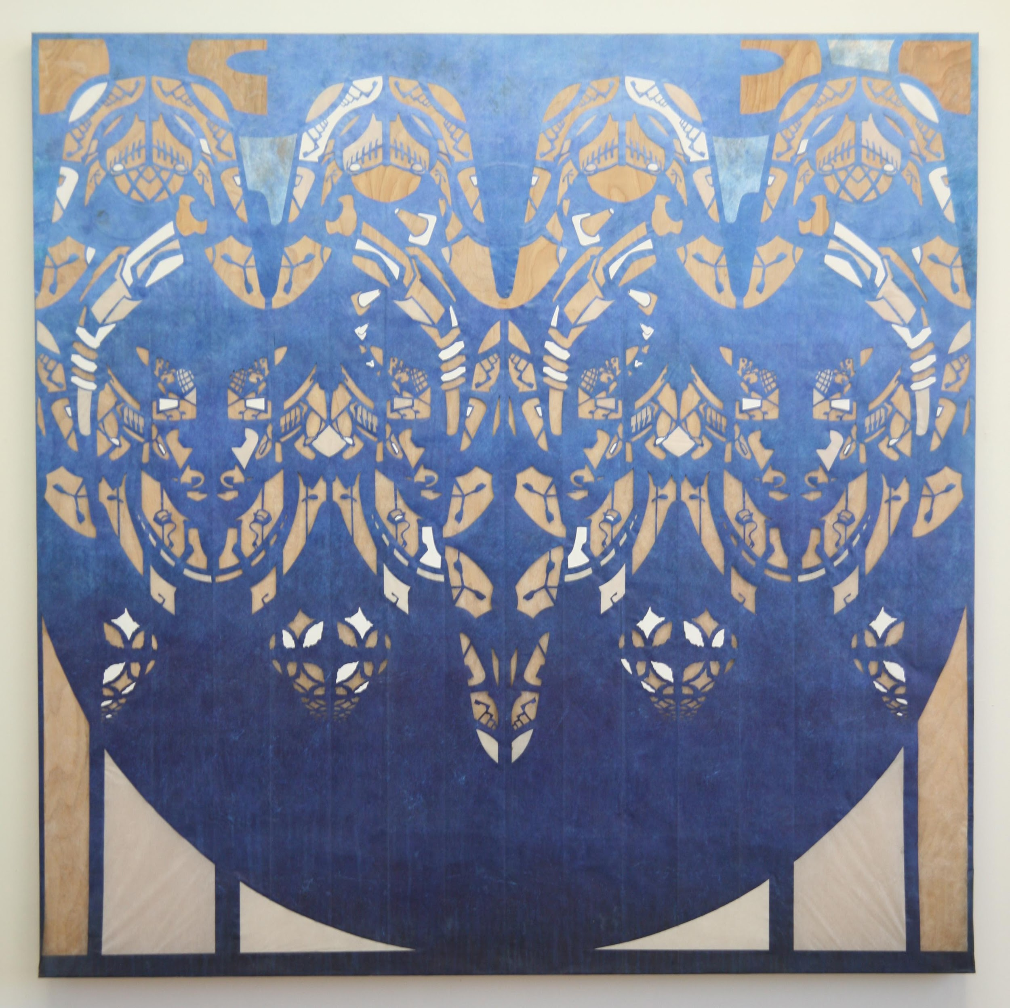
GenevaERS Annual Project Reviews

Slide 2
Project Updates sent for the February 2023 Board Meeting
Capabilities
Replacing zO/S module MR91
Testing has begun on the java version of MR91. Testing is currently testing existing capability of ingesting and processing XML generated from the GenevaERS front end and running on zO/S
Performance Engine build process
Work completed on moving code to internal IBM GitHub
Next steps - finalizing what capabilities will remain in commercial version vs the open source version. Commercial version is for capabilities that require a license to use on the mainframe such as reading from DB2 data sources. Additional criteria for remaining in the commercial version are capabilities that do not align with future state capabilities or are very niche use cases.
Training Documentation
A lot of work completed since August to modernize documentation that was customer / user facing via PDFs. Documentation website is now markdown and Jekyll based using GitHub pages.
New wiki for the workbench demo
Goals
At least one new committer not affiliated with IBM or SAFR users companies
We’ve recently had someone new join our project meetings. He has been receiving overviews on the project.

Slide 3
GenevaERS Project Status - August 2022

Slide 4
Review
Capabilities - Proof of Concepts
Linux on Z
Proved machine code generated on Linux on Z would run as expected on zO/S
Future challenge, changing the performance engine IO for Linux on Z
Docker
Created a container for the workbench and proved the workbench can be used on non-Windows computers
Training Documentation
Phase One completed
Conversion of all existing training documentation to markdown
Output will be pulled into a Jekyll powered site
Demos
In support of original demo released videos “Geneva in One Minute” and “Geneva in Two Minutes” on GenevaTV YouTube channel
Wiki released for the demo
Demo improvements.
New demo workbench released with performance improvements to the demo views.
New wiki for the workbench demo
Published in Enterprise Systems Journal “Open Source Unlocks Mainframe Data: In Situ Analytics with GenevaERS”
Look Ahead
Capabilities
Performance Engine build process
Allows for one build for GenevaERS and SAFR (commercial capabilities)
Java MR91
Replaces zO/S MR91
Complete release strategy
Training Documentation
Complete ingestion of documentation into Jekyll site
Includes automation for GenevaERS and SAFR
Goals
At least one new committer not affiliated with IBM or SAFR users companies
Potential work - build runway to expand capabilities for new docker container

Slide 5
GenevaERS Project Status - August 2021

Slide 6
Background
Initially developed as a product and consulting services asset from late 1980’s through early 2000’s when purchased by IBM as part of acquisition of PwC Consulting
Original name was GenevaERS until IBM Acquisition when it became known as Scalable Architecture for Financial Reporting or SAFR
Effectively a Map-Reduce Engine more than 10 years before development of Map-Reduce in 2004 by Google
Drives incredibly high throughput focused on z/OS on IBM Z Mainframes
A score of very large, enterprise customers over its history, continuing to be supported under contract for some customers
Released as Open Source by IBM in May 2020
Approved as incubation OMP project July 9th, 2020
Project Renewal Status on August 12, 2021

Slide 7
TAC Project Status Application
All OMP Requirements met as listed at https://github.com/genevaers/community/tree/master/tsc
Demo System, including: https://github.com/genevaers/demo#readme
Downloadable executables https://github.com/genevaers/demo/releases/tag/v1.0.0
Sample GenevaERS configuration (XML format)
Sample Execution z/OS Scripting (JCL)
Users Instruction
Code Released:
Java (Frontend Workbench) https://github.com/genevaers/wb
z/OS Assembler (Performance Engine) https://github.com/genevaers/pe
Website (GenevaERS.org, new Linux Foundation GenevaERS.Com soon)
Adopters: Continuing GenevaERS customers
Committers: 17 team members from multiple organizations

Slide 8
Next Steps
Public Build Processes
Enhanced Documentation
Renewed Spark Integration Efforts
Other Enhancements

Slide 9

Video and music copyrighted by
Kip M. Twitchell
Cover image by
Lane Twitchell
“Drip Dropped”
cut olefin and
rice paper on panel
60” x 60” 2018
(detail)
Licensed under
CC BY 4.0

